Slide 1
Cross Cultural Communication

Slide 2
CULTURE

Slide 3
What is culture?
Culture is the ideas, customs, and social behaviour of a particular people or society.
A culture is a way of life of a group of people—the behaviors, beliefs, values and symbols that they accept, generally without thinking about them, and that are passed along by communication and imitation from one generation to the next.

Slide 4

Culture is distinct

Slide 5

What is Cross Cultural Communication?

Slide 6
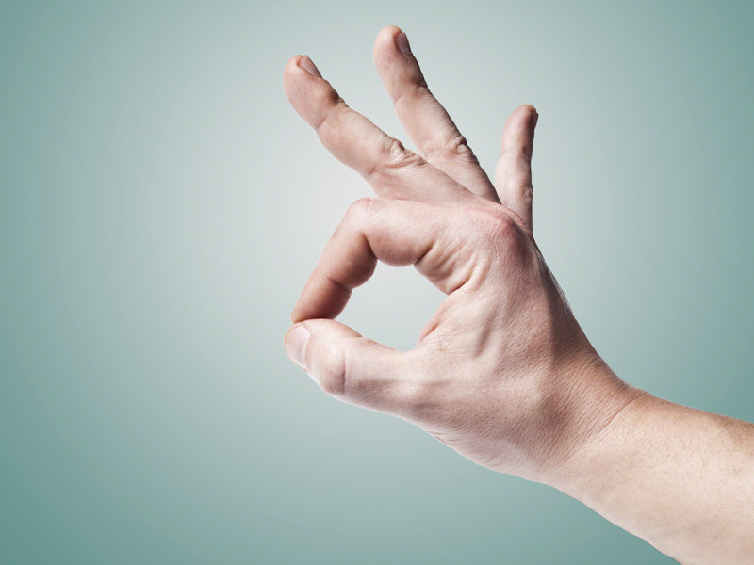

Slide 7
Why cross-cultural communication is important?
Business Opportunities
Job Opportunities
Globalization
Sharing of views and ideas
Understanding of Diverse Market

Slide 8
Potential hot spots in cross culture communication
Opening and Closing Conversations
Taking Turns During Conversations
Interrupting
Use of Silence
Appropriate Topics of Conversation
Knowing How Much to Say

Slide 9
Barriers to Effective Intercultural Communication
Ethnocentrism : Inability to accept another culture's world view; "my way is the best."
Discrimination : Differential treatment of an individual due to minority status; actual and perceived. e.g., "we just aren't equipped to serve people like that."
Stereotyping : Generalizing about a person while ignoring presence of individual difference. e.g., "she's like that because she's Asian – all Asians are nonverbal."

Slide 10
Barriers to Effective Intercultural Communication
Cultural Blindness: Differences are ignored and one proceeds as though differences did not exist; e.g. "there's no need to worry about a person's culture.
Cultural Imposition: Belief that everyone should conform to the majority; e.g., "we know what's best for you, if you don't like it you can go elsewhere."

Slide 11
How to achieve intercultural communicative competence?
Adopt Correct Attitudes
Tolerate ambiguity
Be open-minded
Be altruistic
Acquire Knowledge About Other Cultures
Observe
Formally study
Immerse yourself in other culture

Slide 12
Cont…
Develop Culture-Specific Skills
Practice listening
Practice intercultural empathy
Develop flexibility

Slide 13
Thank you

